Slide 1


SMART FACTORY ASSISTANT

Slide 2
WHY
VISION
We want to make work easier so that you can focus on problems that really matter.
confidential

Slide 3
HOW
PROCESS
We want to get rid of simple and repetitive tasks.
confidential

Slide 4
WHAT
PRODUCT
We are creating assistance systems for workers within smart factories.
confidential

Slide 5
WHAT
PRODUCT
We are creating dedicated virtual voice assistants for smart factories.
confidential

Slide 6
WHAT
PRODUCT
We are creating dedicated virtual assistants for repetitive tasks in the manufacturing space.
confidential

Slide 7

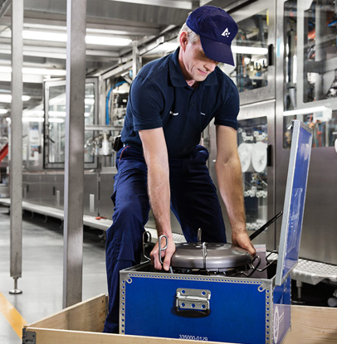
Use Case: Reporting
Developing a Voice Assistant for Service Engineers at Tetra Pak
Paid pilot project at sites of manufacturing partners
Interviewed 42 Service Engineers to validate solution
Oct. - Dec. 2018
confidential

Slide 8


Use Case: Maintenance Reporting
From paper-based reports to an intuitive voice-based interaction at Tetra Pak
PROBLEM
Service Engineers fill out multi-page paper reports after maintenance on a machine is done. This results in a loss of information, costs up to three hours each time and leads to frustration of employees.
SOLUTION
Service Engineers can report their progress in servicing machines on-the-task using an intuitive voice interface and auto-generate the finished report.
Cut potential reporting time per instance by up to 80%
confidential

Slide 9


Creating a report by speech while performing the respective task would be useful - 55%
If you can make writing doctor’s letters suck just a little bit less, you’ll make a fortune with us - 100%
Feedback received so far
Service engineers from Tetra Pak
n = 42
Friends who study medicine
n = 5

Slide 10
What’s our goal?
We want to develop a modular smart factory solution, which solves the problems of our partners. Therefore we need to understand our partners’ pains.
Understand our partners’ pains
Drive innovation within our partners’ factories
confidential

Slide 11
SINCE TMS
TECHNICAL FEASIBILITY
Implementation of natural language processing for populating report. Audio recording of maintenance event to assure general Speech-to-Text translation.
VALIDATED SE INTEREST
Investigation of current process. Interviews with TMS prototype. Workaround solutions with SMS, Email, Google forms.
TETRA PAK STANDARDS
Validated interest in chatbot solution and alignment with other chatbot projects inside Tetra Pak. Cyber security discovery.
Notes:
So, what did we do since TMS? (There is more text on this slide to highlight that we actually did quite a lot. Don’t go too much into detail.)
Technical feasibility proved: Natural language processing (NLP) is for extracting meaning and intents from sentences. NLP works fine. Speech to text translation works generally okay. From the recording with very loud background noise it was able to extract general parts of the sentences. Proper names are a bit more complicated but there is a Microsoft service for this: With Microsoft Azure’s cognitive services customized language models for industry expressions and acoustic models for background noise reduction can be trained for which we need more audio recordings from industry sites.
SEs interest validated: We took our TMS prototype and showed it to SEs resulting in a validated interest from the SEs site. We asked the SEs how they currently do it and with this information we built our second, way more advanced prototype. We tried workarounds via SMS, Email and Google forms which all proved there is a better way and the SEs are open for it.
Tetra Pak Standards: Inside Tetra Pak there is a general interest in chatbot solutions and already a few other chatbot projects, which focus all on different problem spaces. To assure cyber security the solution should be fully integratable in Microsoft Azure. (If questions why now chatbot - before I mentioned virtual voice assistant - it’s basically the same technology and in our case you can interact with the assistant on both ways, with voice and with writing text)

Slide 12

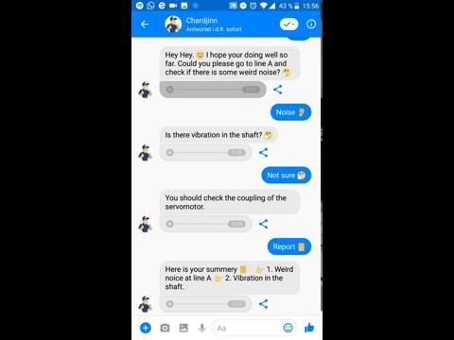
Notes:
I’m only using my voice! Just used my keyboard “m” to activate the microphone! You should be able to hear something. Only focus on the yellow stuff. In the end you can see a yellow report.
This prototype uses our own developed architecture to extract all information spoken and generates a report, which has the same structure as an original Tetra Pak maintenance report.
If somebody asks why it’s a little bit slow: This is the fault of Microsoft. The Speech-to-Text service is a little bit slow and stored in the cloud. Later an offline Speech-to-Text model is favourable.

Slide 13
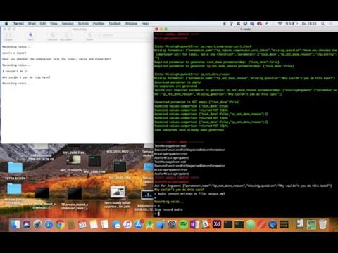
Notes:
I’m only using my voice! Just used my keyboard “m” to activate the microphone! You should be able to hear something. Only focus on the yellow stuff. In the end you can see a yellow report.
This prototype uses our own developed architecture to extract all information spoken and generates a report, which has the same structure as an original Tetra Pak maintenance report.
If somebody asks why it’s a little bit slow: This is the fault of Microsoft. The Speech-to-Text service is a little bit slow and stored in the cloud. Later an offline Speech-to-Text model is favourable.

Slide 14
Use Case: Maintenance Reporting
From paper-based reports to an intuitive voice-based interaction at Tetra Pak
PROBLEM
Service Engineers fill out multi-page paper reports after maintenance on a machine is done. This results in a loss of information, costs up to three hours each time and leads to frustration of employees.
SOLUTION
Service Engineers can report their progress in servicing machines on-the-task using an intuitive voice interface and auto-generate the finished report.
Cut potential reporting time per instance by up to 80%
confidential

Slide 15
WHAT’S SPECIAL
Very specific field of application
Standardized parameters for modularity
Functions can be built on top of each other for more complex tasks
Notes:
BACKUP SLIDE
What’s special about the architecture and our solution and different to other virtual assistants like Siri, Google Assistant and Alexa
Very specific field of applications: All other named assistants are for home use. At home there are no clearly structured processes like in industry is.
Standardized parameters for modularity: In this solutions all parameters and quantities have a specific structure. This is perfect for modularity, to build functions on top of each other and to save stuff in large databases.
Functions can be built on top of each other for more complex tasks: With the previous named standardized parameters it’s possible to build multiple functions on top of each other and therefore the assistant can do way more complex tasks and really help the people.

Slide 16
Product: What’s Special
Digital Assistants, Dedicated to the Manufacturing Environment
Integrity
Voice Assistants either standalone or integrated into your favorite Apps, such as Microsoft Teams
Performance
Proprietary architecture allows for representing complex tasks, unachieved by current standards
Hier muss noch was Aussagekräftiges hin. Ggf. nachbessern
confidential

Slide 17

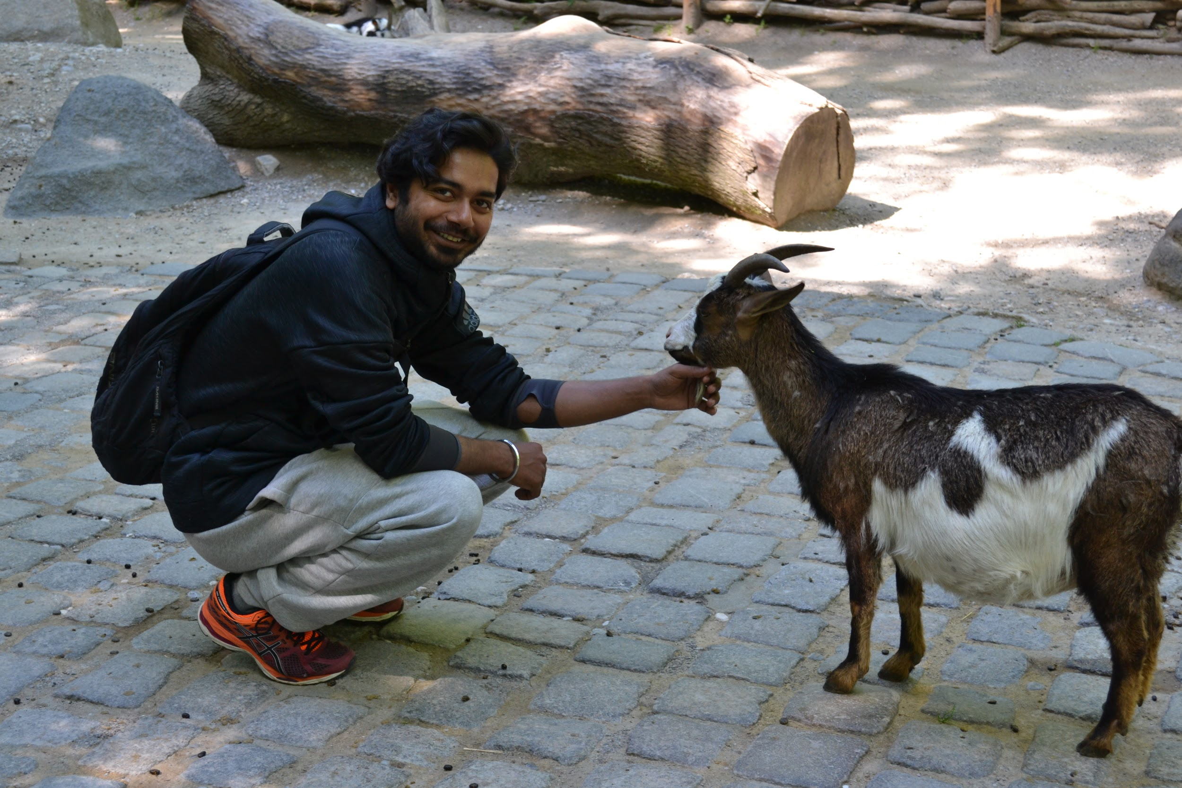
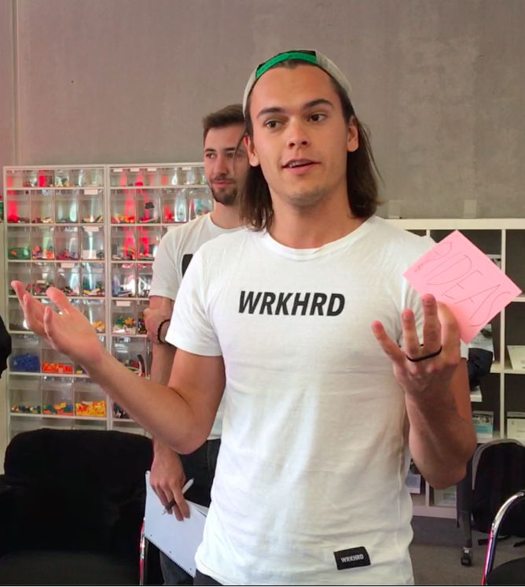










Team: Design Thinkers
Viran
AI & Analytics
Louis
Business
Maxi
Product
Rakesh
Tech

Slide 18
Team: Design Thinkers
Viran
AI & Analytics
MSc. Computer Science
Digital Product School Scholar
Louis
Business
MSc. Mgmt&Technology
Manage&More Scholar
Maxi
Product
MSc. Particle Physics
Manage&More Scholar
Rakesh
Tech
MSc. Computer Science
Digital Product School Scholar

Slide 19
Who we are
An interdisciplinary team of creators and innovators
Viran
AI & Analytics
MSc. Computer Science
Digital Product School Scholar
Louis
Business
MSc. Mgmt and Technology
Manage&More Scholar
Maxi
Product
MSc. Particle Physics
Manage&More Scholar
Rakesh
Tech
MSc. Computer Science
Digital Product School Scholar

Slide 20
We bring creativity and innovation to your processes
Viran
AI & Analytics
Louis
Business
Maxi
Product
Rakesh
Tech

Slide 21
WE’RE LOOKING FOR PROBLEMS
DIGITAL ASSISTANTS
We would like to explore the topic of digital assistants and how they could streamline your manufacturing operations.
SMART FACTORY
We would like to explore problem fields within the smart factory space and how intelligent processes can be designed.
HUMAN-MACHINE-INTERACTION
We would like to explore applications of digital assistants in the HMI space and how they might enable effective cooperation between humans and machines.
confidential

Slide 22
WE WANT TO UNDERSTAND YOUR PAINS
VIRTUAL ASSISTANTS
We explore the topic of digital assistants and how they could streamline your manufacturing operations.
SMART FACTORY
We explore problem fields within the smart factory space and how intelligent processes can be designed.
HUMAN-MACHINE-INTERACTION
We explore applications of digital assistants in the HMI space and how they might enable effective cooperation between humans and machines.
confidential

Slide 23

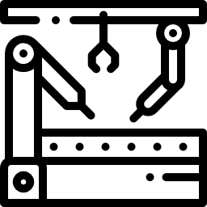

WE WANT TO UNDERSTAND YOUR PAINS
VIRTUAL ASSISTANTS
We explore the topic of digital assistants and how they could streamline your manufacturing operations.
SMART FACTORY
We explore problem fields within the smart factory space and how intelligent processes can be designed.
HUMAN-MACHINE-INTERACTION
We explore applications of digital assistants in the HMI space and how they might enable effective cooperation between humans and machines.
confidential

Slide 24
What we offer
No-worries-approach to innovation in your factory
FREE, NON-BINDING PROBLEM EXPLORATION
Together with you or based on provided resources, we explore opportunities for improvement. No risk for you whatsoever.
UNIVERSITY BACKED
We apply latest research from the world’s leading universities to problems in the manufacturing space. We use agile and lean methods to develop solutions.
PILOT PROJECTS IN A LATER STAGE
After we’ve identified the opportunities for improvement and defined dedicated solutions, we realize these with you within the scope of a pilot project.
We
innovation
confidential

Slide 25
Our efforts
Search for a space where we fit in
Develop a scalable business model
Understand the market
Businessplan Seminar
Search for problems with current solutions
Insights from company
Understand the underlying problem
First money for team development
Pilot Project
No-worries Approach
Validate other companies have similar problems
Find new pilot projects
Sharpen the problem space
confidential
Notes:
Own Architecture is missing. How do we combine our technology field with other currently new interesting and promising tech. Fields -> technology push

Slide 26



GET IN TOUCH
LOUIS ERBER
+49 (0) 157 70302399
louis.erber@manageandmore.de
Notes:
BACKUP SLIDE
What’s special about the architecture and our solution and different to other virtual assistants like Siri, Google Assistant and Alexa
Very specific field of applications: All other named assistants are for home use. At home there are no clearly structured processes like in industry is.
Standardized parameters for modularity: In this solutions all parameters and quantities have a specific structure. This is perfect for modularity, to build functions on top of each other and to save stuff in large databases.
Functions can be built on top of each other for more complex tasks: With the previous named standardized parameters it’s possible to build multiple functions on top of each other and therefore the assistant can do way more complex tasks and really help the people.

